Slide 1
ARM Cortex-M4
Combines DSP and microcontroller features
Adds instructions, including DSP and SIMD instructions, and FPU to the ARM Cortex-M3
Using these hardware features, together with code optimization strategies, Cortex-M4 C-code can approach the efficiency of DSPs for implementation of DSP algorithms
Cortex-M4 is a microcontroller with real-time audio processing capability

Slide 2
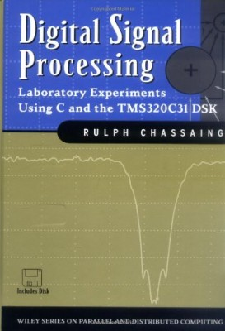
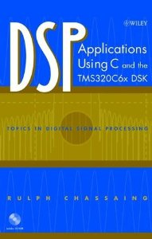
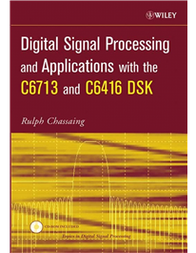
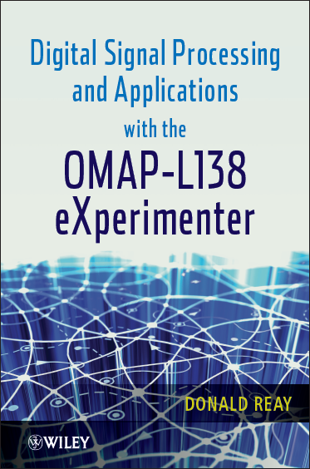
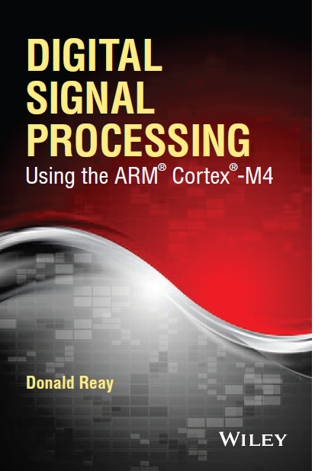
Hands-On DSP Teaching Texts

Slide 3
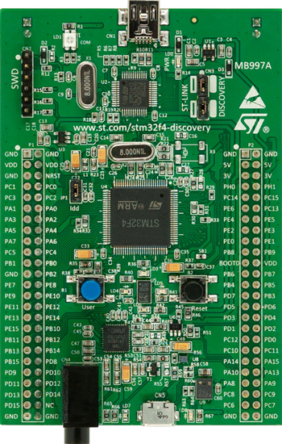
ARM Cortex-M4 Hardware Platform
STM32F407 ARM Cortex-M4
168 MHz clock
128 kB RAM
1 MB Flash
FPU, 2 x 12-bit DAC
3 x 16-channel 12-bit ADC, 2.4MSPS
I2C, I2S
MEMS microphone
3-axis accelerometer
Accessible i/o pins
Audio DAC
ST-LINK
User push button
User LEDs
STM32F407
Discovery
$15

Slide 4
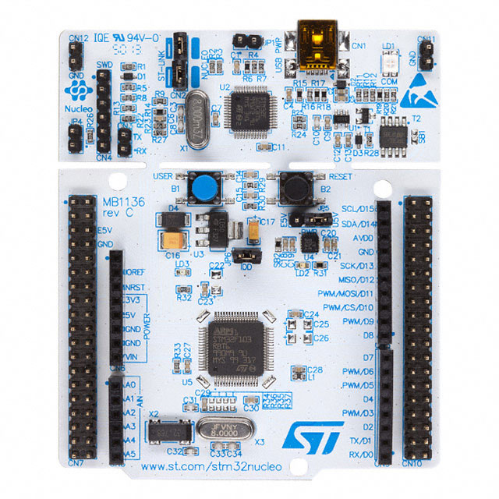
ARM Cortex-M4 Hardware Platform
STM32F401 ARM Cortex-M4
84 MHz clock
96 kB RAM
512 kB Flash
FPU
1 x 16-channel 12-bit ADC, 2.4MSPS
I2C, I2S
Arduino connectivity
mbed-enabled
Accessible i/o pins
ST-LINK
User push button
User LED
STM32F401
Nucleo
$10

Slide 5
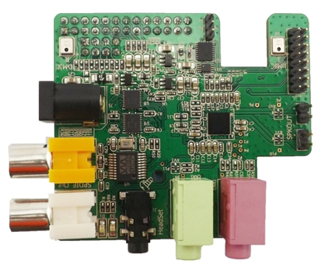
ARM Cortex-M4 Hardware Platform
Wolfson Audio Card
WM5102 audio hub codec
192 kHz stereo
High quality audio
Programmable filters
{audio DSP}
Class D speaker driver
WM8804 SPDIF transceiver
Stereo digital MEMS microphones
LINE IN, LINE OUT, HEADSET (Samsung, Apple)
Can use plain headphones or TRRS-wired microphone
$34

Slide 6
Audio Card Connections
BCLK
WCLK
DOUT
DIN
SCL
SDA
RESET
5V
GND

Slide 7
Audio Card Connections
BCLK
WCLK
DOUT
DIN
SCL
SDA
RESET
5V
GND

Slide 8
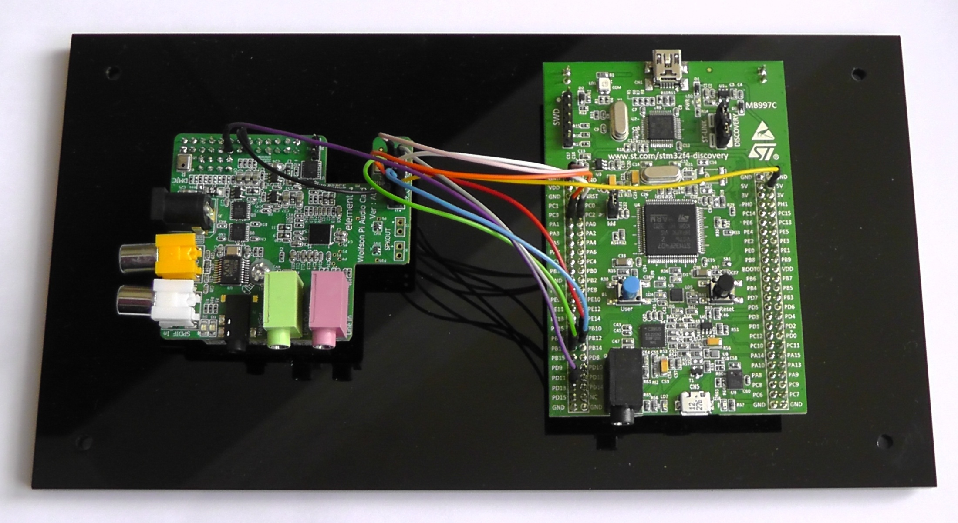
Audio Card Connections
Wolfson Audio Card connected to STM32F407 Discovery

Slide 9
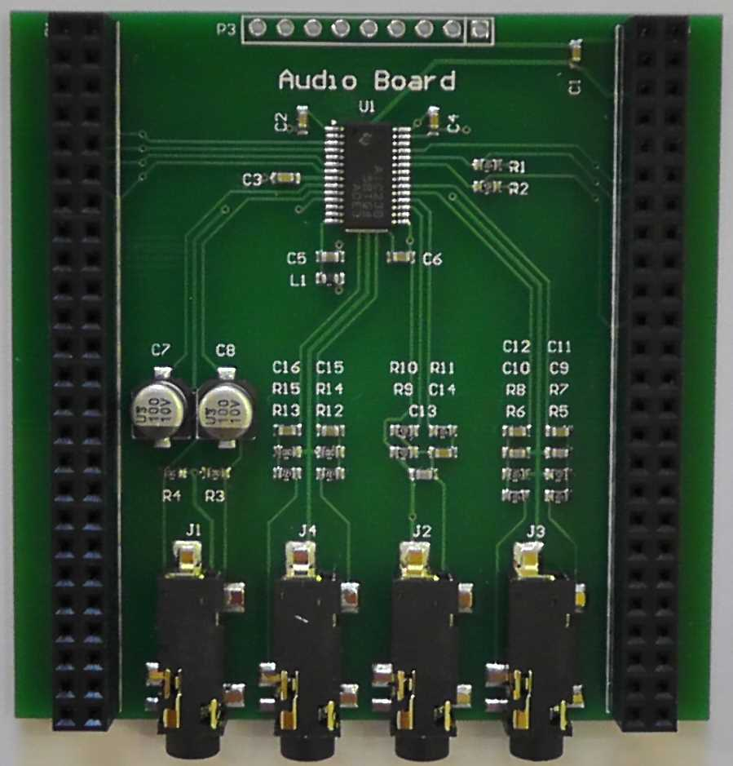
ARM Cortex-M4 Hardware Platform
Audio Board for STM32F407 Discovery
Texas Instruments AIC23 audio codec
8kHz – 48kHz sampling rates
LINE IN, LINE OUT, MIC IN, HP OUT
audio board for
STM32F407 Discovery

Slide 10
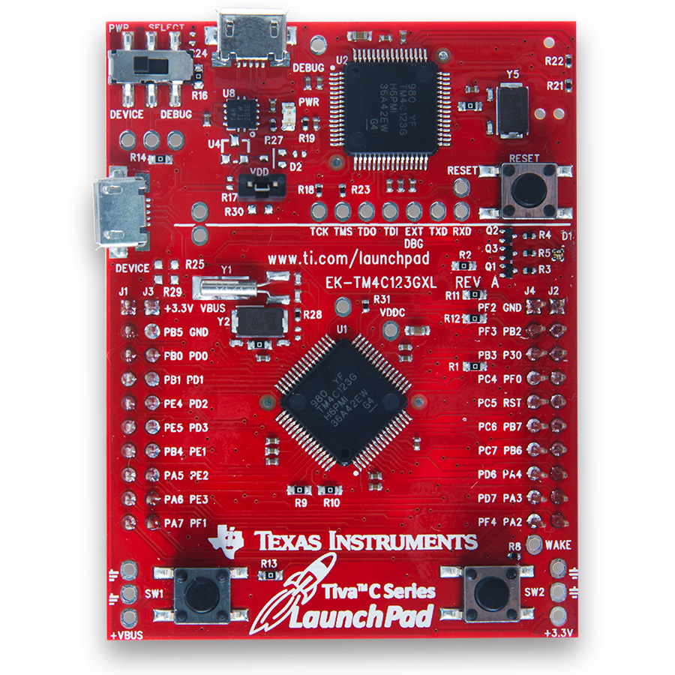
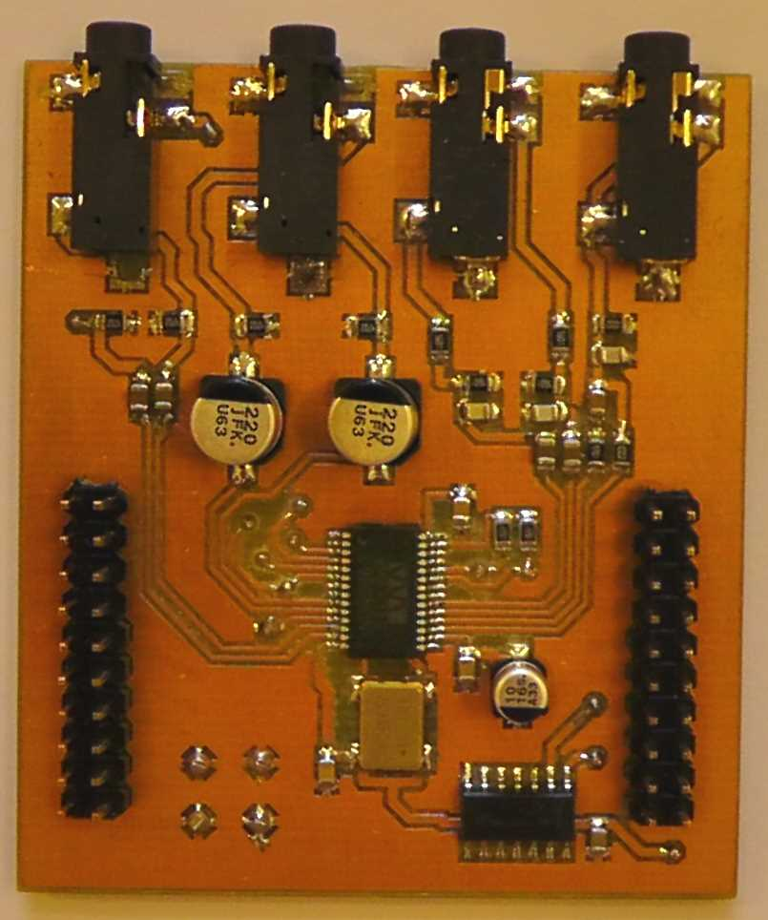
ARM Cortex-M4 Hardware Platform
$13
Texas Instruments TM4C123 ARM Cortex-M4F
80 MHz clock
32 kB RAM on-chip
256 kB Flash on-chip
FPU, I2C, I2S emulation
Audio BoosterPack
Cirrus Logic WM8731 audio codec
8kHz – 48kHz sampling rates
LINE IN, LINE OUT, MIC IN, HP OUT
TM4C123
LaunchPad
design files
available on-line
Audio
BoosterPack

Slide 11
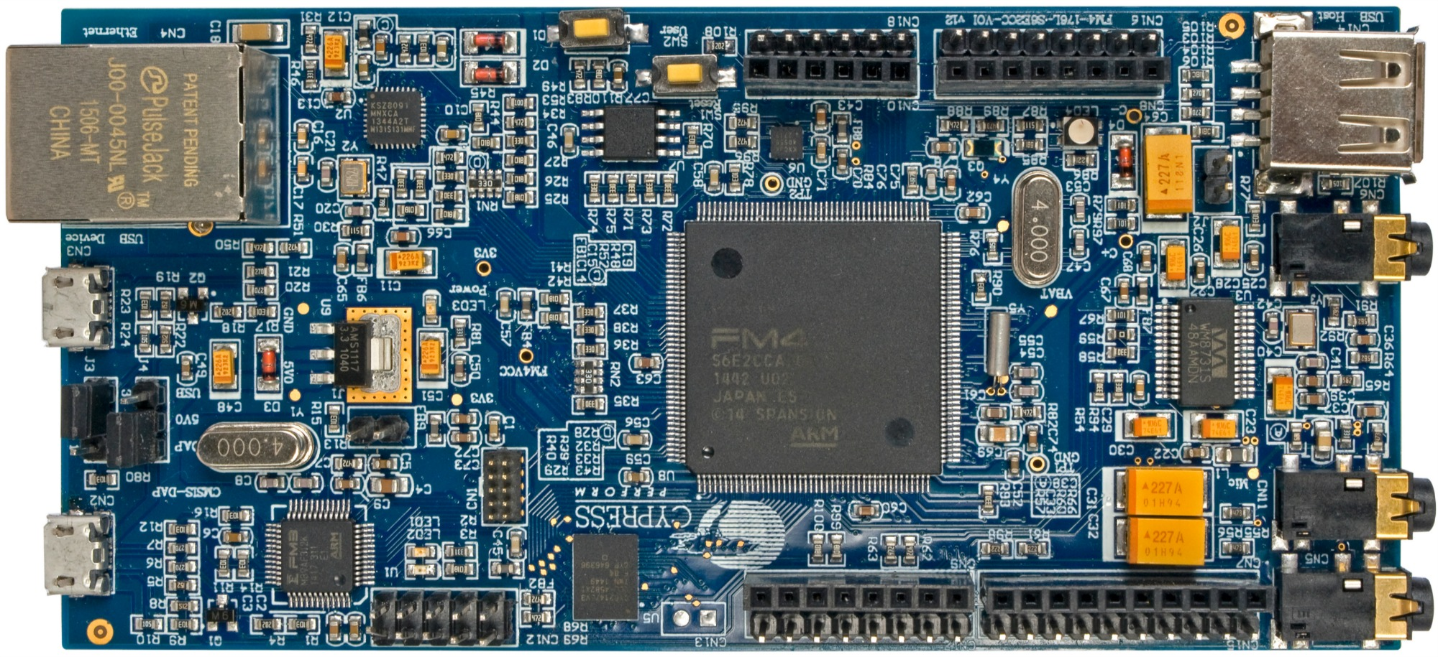
ARM Cortex-M4 Hardware Platform
Cypress Semiconductor FM4
200 MHz clock
256 kB RAM on-chip
2 MB Flash on-chip
FPU, I2C (SPI), I2S
Wolfson WM8731 audio codec
8kHz – 96kHz sampling rates
LINE IN, MIC IN, HP OUT
$45
Cypress FM4 S6E2CC Pioneer Kit

Slide 12
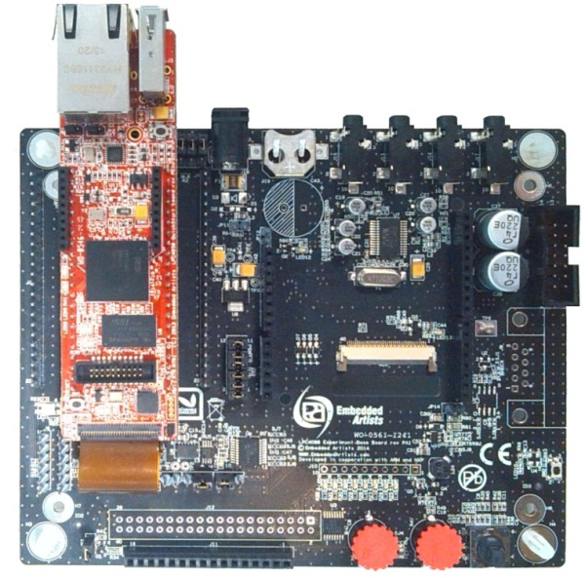
ARM Cortex-M4 Hardware Platform
NXP LPC4088QSB
NXP LPC4088 ARM Cortex-M4F
120 MHz clock
96 kB RAM on-chip
512 kB Flash on-chip
FPU, I2C, I2S
mbed enabled
Wolfson WM8731 audio codec
8kHz – 48kHz sampling rates
LINE IN, LINE OUT, MIC IN, HP OUT
user joystick switch
potentiometers
user LEDs
$90
Embedded Artists
Experiment Base board

Slide 13
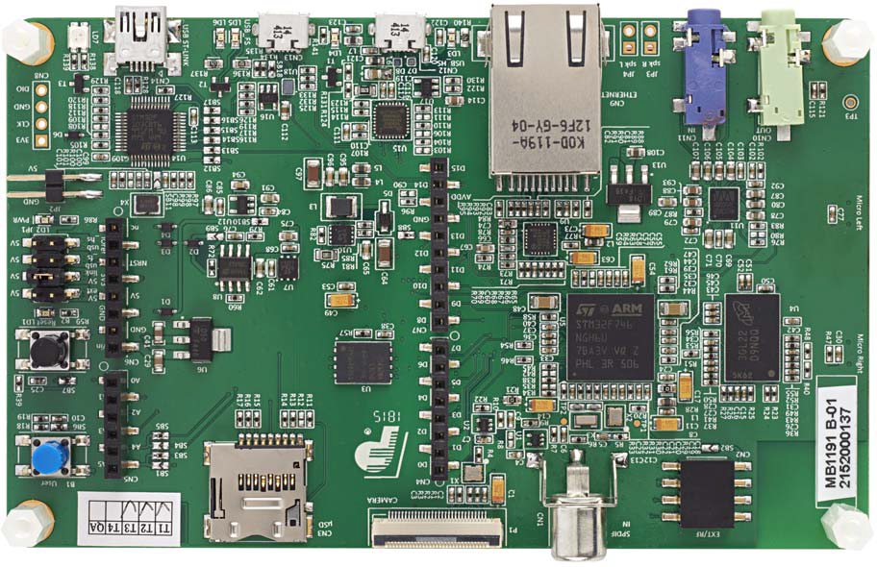
ARM Cortex-M7 Hardware Platform
STM32F746G ARM Cortex-M7F
212 MHz clock
FPU, I2C, I2S
2 x 12-bit DAC
mbed enabled
Cirrus Logic WM8994 audio codec
8kHz – 48kHz sampling rates
LINE IN, HP OUT
user pushbutton
user LED
Arduino connectors
MEMS digital microphones
STM32F746G Discovery
$45
$45

Slide 14
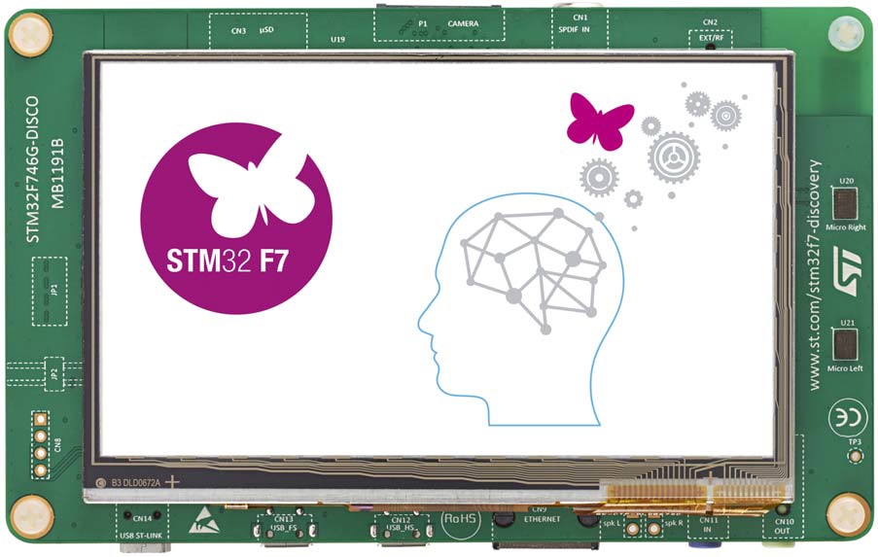
ARM Cortex-M4 Hardware Platform
STM32F746G Discovery
STM32F746G ARM Cortex-M7F
212 MHz clock
FPU, I2C, I2S
2 x 12-bit DAC
mbed enabled
Cirrus Logic WM8994 audio codec
8kHz – 48kHz sampling rates
LINE IN, HP OUT
user pushbutton
user LED
Arduino connectors
MEMS digital microphones
272 x 470 pixel LCD

Slide 15
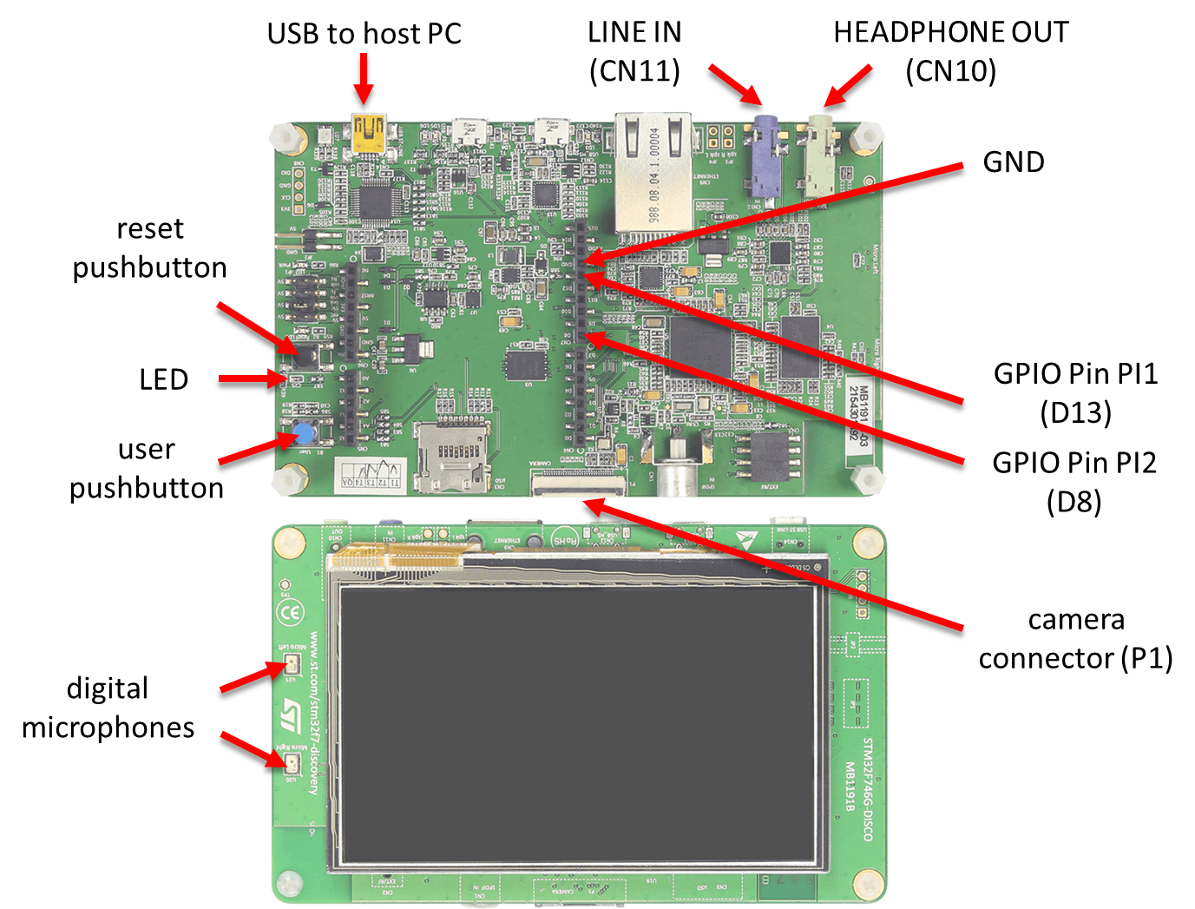
STM32F746G Discovery Board Connections

Slide 16
ARM University Program DSP Education Kit
DSP Education Kit is a resource comprising hardware, software and teaching materials, available from ARM University Program.
It aims to enhance DSP teaching by enabling the incorporation of hands-on DSP laboratory exercises into a course.
It is based on the use of ARM Cortex-M4 or Cortex-M7 processors.
It joins an expanding family of Education Kits
ARM University Program donates materials, licences and hardware to professors.
Cypress and ST hardware options currently available.

Slide 17
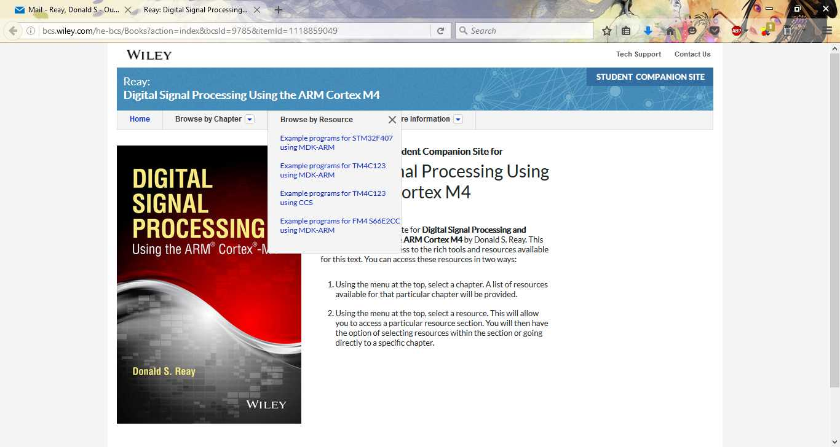
Digital Signal Processing using the ARM Cortex-M4

Slide 18
Digital Signal Processing using the ARM Cortex-M4
Book describes a superset of the program examples in the DSP Education Kit.
Includes theory sections.
Program examples downloadable for STMicroelectronics, Texas Instruments, and Cypress hardware platforms.
Program code is conceptually similar to, but has more functionality and in some details is incompatible with that provided in DSP Education Kit.

Slide 19
Topics Covered (by Education Kit and by book)
Introduction
Analog Input and Output
Finite Impulse Response Filters
Infinite Impulse Response Filters
Fast Fourier Transform
Adaptive Filters

Slide 20
Talk Through Using Interrupt-Based i/o
STM32F746G Discovery Board
HP
program stm32f7_loop_intr.c

Slide 21
Talk Through Using Interrupt-Based i/o
// stm32f7_loop_intr.c
#include "stm32f7_wm8994_init.h"
#include "display.h"
#define SOURCE_FILE_NAME "stm32f7_loop_intr.c"
extern int16_t rx_sample_L, rx_sample_R;
extern int16_t tx_sample_L, tx_sample_R;
void BSP_AUDIO_SAI_Interrupt_CallBack(){
tx_sample_L = rx_sample_L;
tx_sample_R = rx_sample_R;
BSP_LED_Toggle(LED1);
return;
}
int main(void){
stm32f7_wm8994_init(AUDIO_FREQUENCY_48K, IO_METHOD_INTR, INPUT_DEVICE_DIGITAL_MICROPHONE_2,
OUTPUT_DEVICE_HEADPHONE, WM8994_HP_OUT_ANALOG_GAIN_0DB,
WM8994_LINE_IN_GAIN_0DB, WM8994_DMIC_GAIN_9DB, SOURCE_FILE_NAME, NOGRAPH);
while(1) {}
}

Slide 22
Talk Through Using Interrupt-Based i/o
// stm32f7_loop_intr.c
#include "stm32f7_wm8994_init.h"
#include "display.h"
#define SOURCE_FILE_NAME "stm32f7_loop_intr.c"
extern int16_t rx_sample_L, rx_sample_R;
extern int16_t tx_sample_L, tx_sample_R;
void BSP_AUDIO_SAI_Interrupt_CallBack(){
tx_sample_L = rx_sample_L;
tx_sample_R = rx_sample_R;
BSP_LED_Toggle(LED1);
return;
}
int main(void){
stm32f7_wm8994_init(AUDIO_FREQUENCY_48K, IO_METHOD_INTR, INPUT_DEVICE_DIGITAL_MICROPHONE_2,
OUTPUT_DEVICE_HEADPHONE, WM8994_HP_OUT_ANALOG_GAIN_0DB,
WM8994_LINE_IN_GAIN_0DB, WM8994_DMIC_GAIN_9DB, SOURCE_FILE_NAME, NOGRAPH);
while(1) {}
}

Slide 23
Talk Through Using Interrupt-Based i/o
// stm32f7_loop_intr.c
#include "stm32f7_wm8994_init.h"
#include "display.h"
#define SOURCE_FILE_NAME "stm32f7_loop_intr.c"
extern int16_t rx_sample_L, rx_sample_R;
extern int16_t tx_sample_L, tx_sample_R;
void BSP_AUDIO_SAI_Interrupt_CallBack(){
tx_sample_L = rx_sample_L;
tx_sample_R = rx_sample_R;
BSP_LED_Toggle(LED1);
return;
}
int main(void){
stm32f7_wm8994_init(AUDIO_FREQUENCY_48K, IO_METHOD_INTR, INPUT_DEVICE_DIGITAL_MICROPHONE_2,
OUTPUT_DEVICE_HEADPHONE, WM8994_HP_OUT_ANALOG_GAIN_0DB,
WM8994_LINE_IN_GAIN_0DB, WM8994_DMIC_GAIN_9DB, SOURCE_FILE_NAME, NOGRAPH);
while(1) {}
}

Slide 24
Talk Through Using Interrupt-Based i/o
STM32F746G Discovery Board
HP
program stm32f7_loop_intr.c

Slide 25
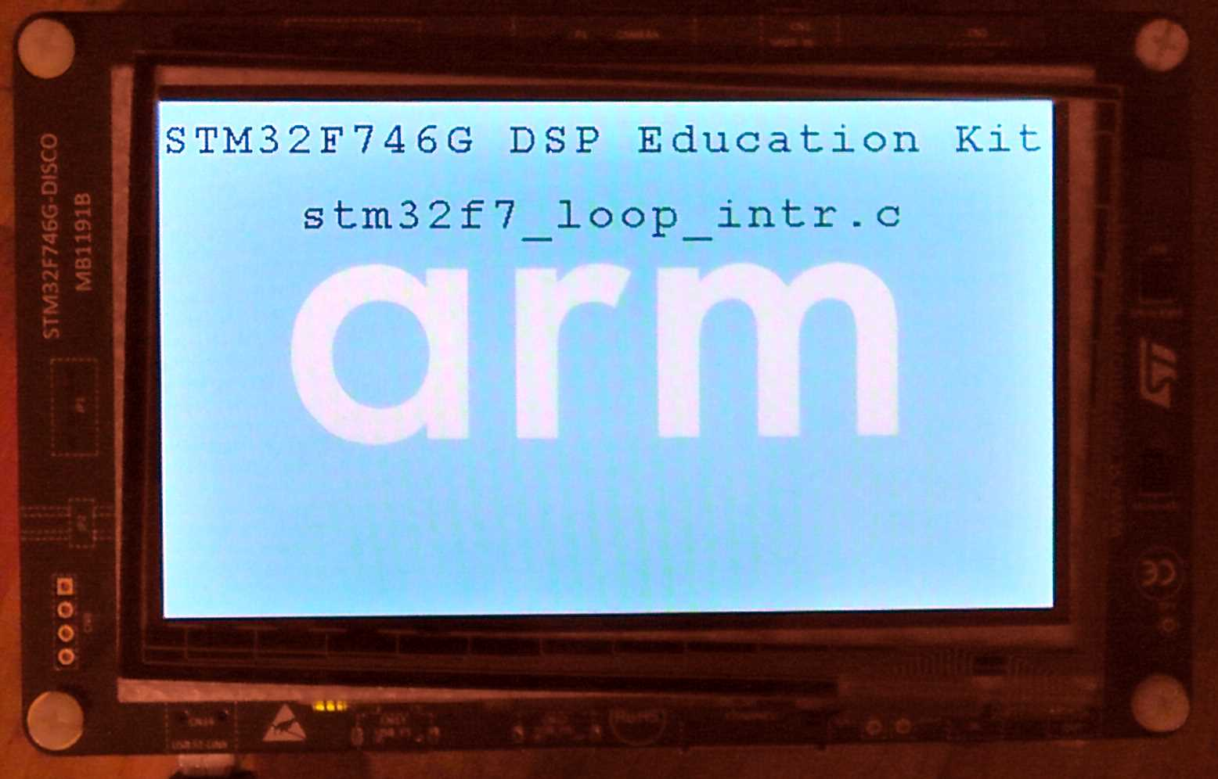
Talk Through Using Interrupt-Based i/o

Slide 26
Talk Through Using Interrupt-Based i/o
// stm32f7_loop_intr.c
#include "stm32f7_wm8994_init.h"
#include "display.h"
#define SOURCE_FILE_NAME "stm32f7_loop_intr.c"
extern int16_t rx_sample_L, rx_sample_R;
extern int16_t tx_sample_L, tx_sample_R;
void BSP_AUDIO_SAI_Interrupt_CallBack(){
tx_sample_L = rx_sample_L;
tx_sample_R = rx_sample_R;
BSP_LED_Toggle(LED1);
return;
}
int main(void){
stm32f7_wm8994_init(AUDIO_FREQUENCY_48K, IO_METHOD_INTR, INPUT_DEVICE_DIGITAL_MICROPHONE_2,
OUTPUT_DEVICE_HEADPHONE, WM8994_HP_OUT_ANALOG_GAIN_0DB,
WM8994_LINE_IN_GAIN_0DB, WM8994_DMIC_GAIN_9DB, SOURCE_FILE_NAME, NOGRAPH);
while(1) {}
}

Slide 27
STM32F746G Discovery Board Connections

Slide 28
Sine Wave Generation Using Interrupt-Based i/o
// stm32f7_sine_lut_intr.c
#include "stm32f7_wm8994_init.h“
#include "stm32f7_display.h"
#define SOURCE_FILE_NAME "stm32f7_sine_lut_intr.c"
#define LOOPLENGTH 8
extern int16_t rx_sample_L, rx_sample_R, tx_sample_L, tx_sample_R;
int16_t sine_table[LOOPLENGTH] = {0, 7071, 10000, 7071, 0, -7071, -10000, -7071};
int16_t sine_ptr = 0; // pointer into lookup table
void BSP_AUDIO_SAI_Interrupt_CallBack(){
BSP_LED_On(LED1);
tx_sample_L = sine_table[sine_ptr];
sine_ptr = (sine_ptr+1)%LOOPLENGTH;
tx_sample_R = tx_sample_L;
BSP_LED_Off(LED1);
return;
}
int main(void){
stm32f7_wm8994_init(AUDIO_FREQUENCY_8K, IO_METHOD_INTR, INPUT_DEVICE_INPUT_LINE_1,
OUTPUT_DEVICE_HEADPHONE, WM8994_HP_OUT_ANALOG_GAIN_0DB,
WM8994_LINE_IN_GAIN_0DB, WM8994_DMIC_GAIN_9DB, SOURCE_FILE_NAME,
GRAPH);
plotSamples(sine_table, LOOPLENGTH, 32);
while(1){}
}

Slide 29
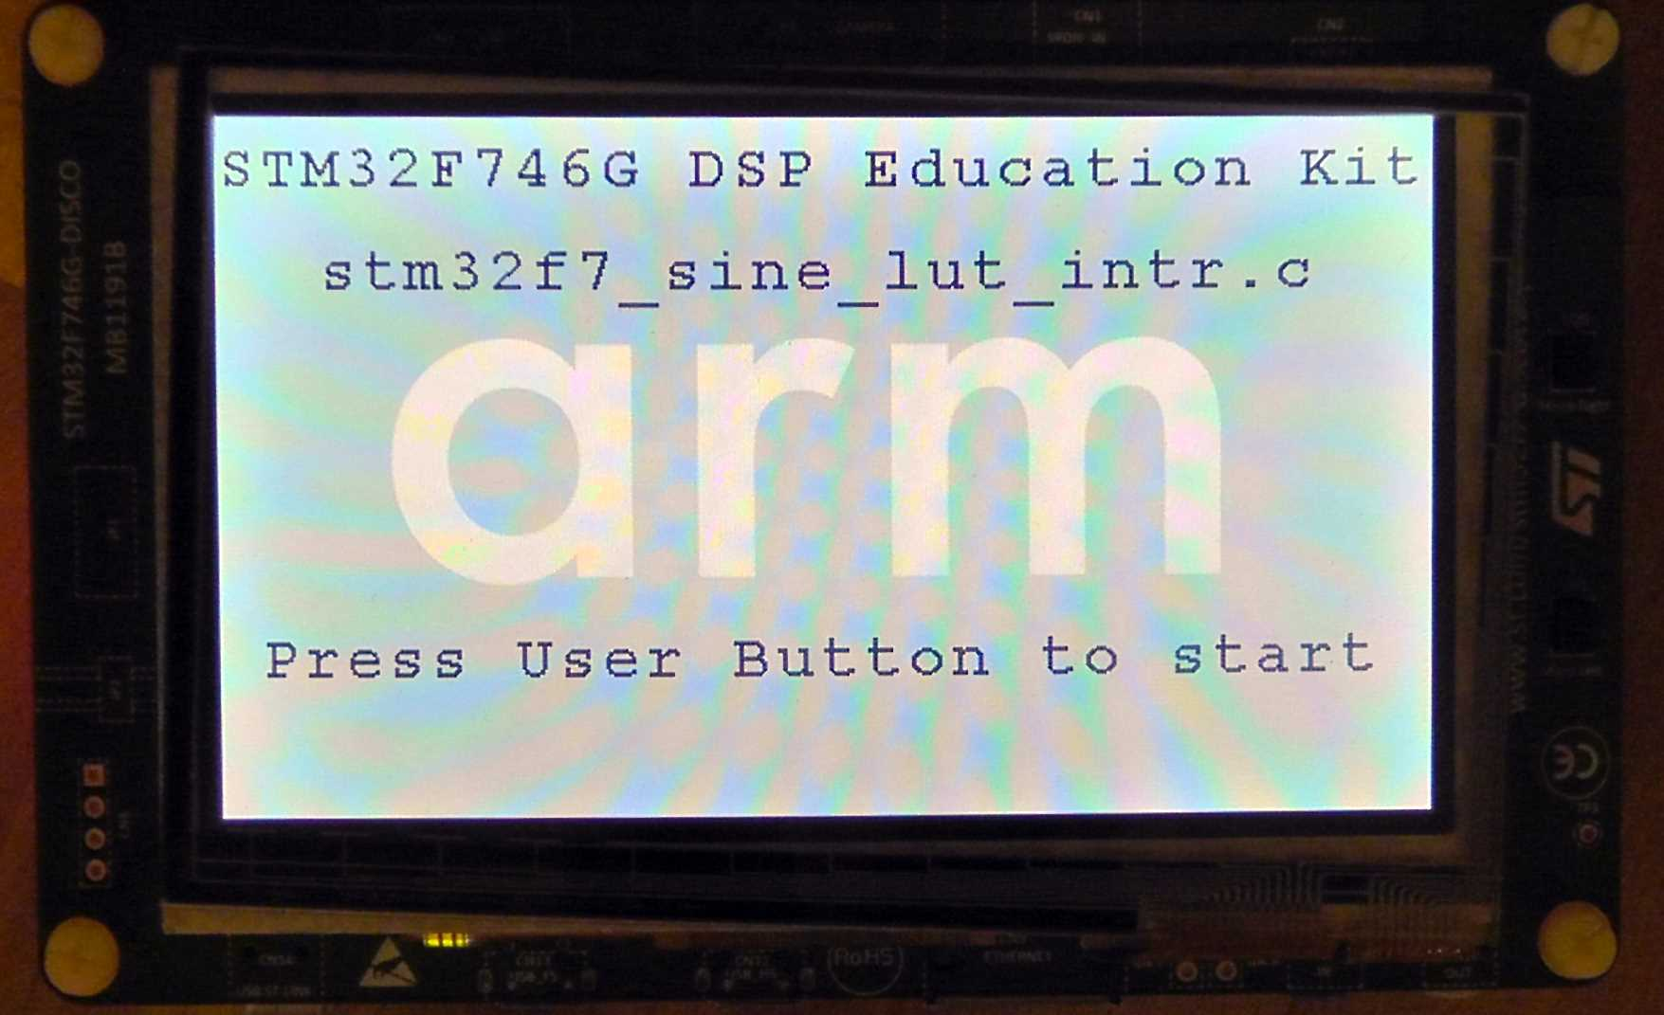
Sine Wave Generation Using Interrupt-Based i/o
LCD start screen for program stm32f7_sine_lut_intr.c.

Slide 30
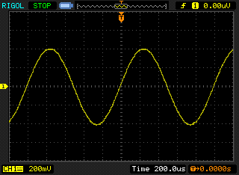
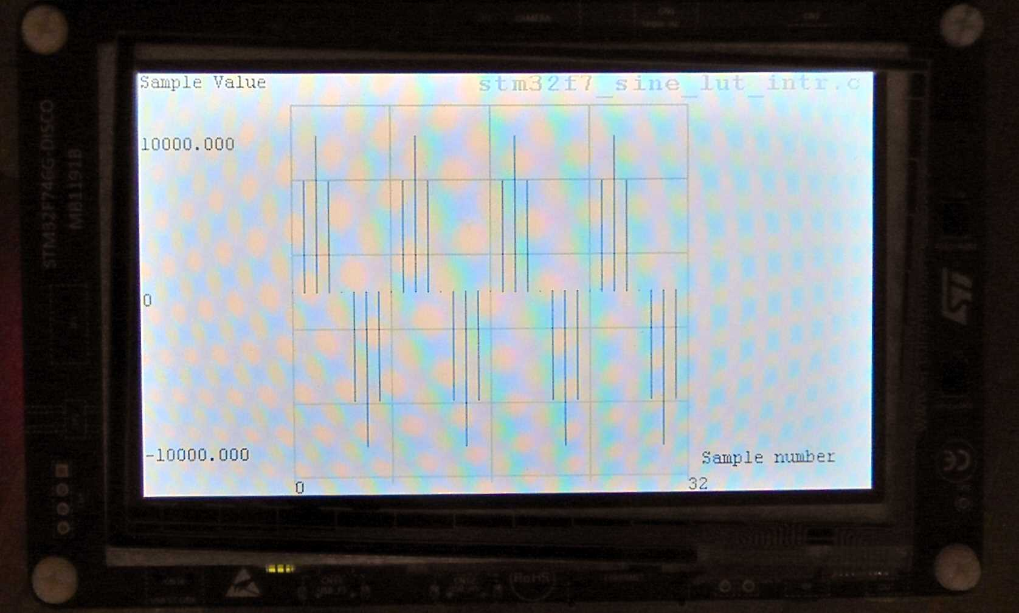
Sine Wave Generation Using Interrupt-Based i/o
1 kHz sine wave generated using program stm32f7_sine_lut_intr.c.

Slide 31

Comparison of audio DAC with zero-order hold DAC
1 kHz sinusoid generated from 8-value LUT,
fs = 8 kHz, using WM8994 codec
1 kHz sinusoid generated from 8-value LUT,
fs = 8 kHz, using 12-bit on-chip DAC

Slide 32
Sine Wave Generation Using Interrupt-Based i/o
// stm32f7_sine_intr.c
float32_t sine_frequency = 367.0;
float32_t amplitude = 10000.0;
float32_t theta_increment;
float32_t theta = 0.0;
void BSP_AUDIO_SAI_Interrupt_CallBack(){
theta_increment = 2*PI*sine_frequency/SAMPLING_FREQ;
theta += theta_increment;
if (theta > 2*PI) theta -= 2*PI;
BSP_LED_On(LED1);
// tx_sample_L = (int16_t)(amplitude*sin(theta));
// tx_sample_L = (int16_t)(amplitude*sinf(theta));
tx_sample_L = (int16_t)(amplitude*arm_sin_f32(theta));
tx_sample_R = tx_sample_L;
BSP_LED_Off(LED1);
plotSamplesIntr(tx_sample_L, 32);
return;
}

Slide 33
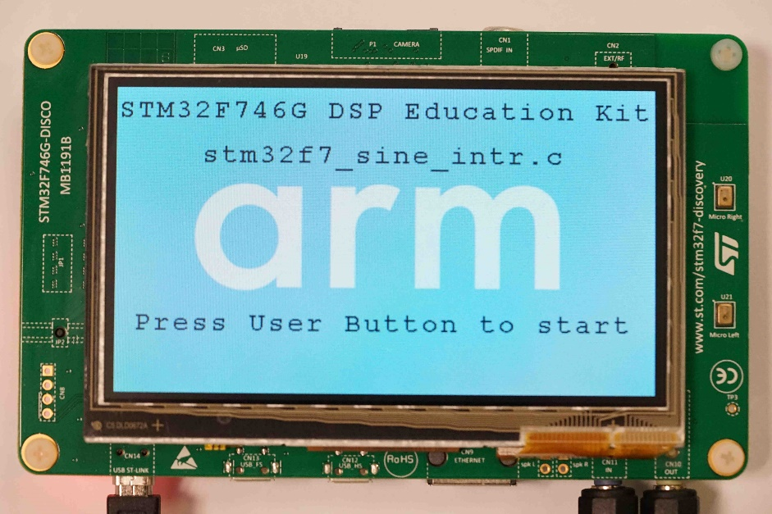
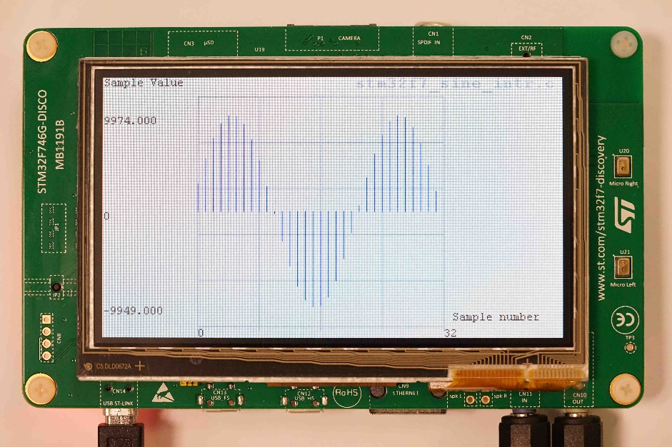
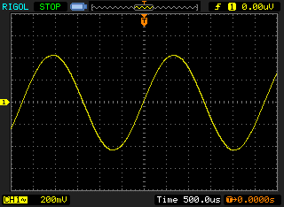
Sine Wave Generation Using Interrupt-Based i/o
367Hz sine wave generated using program stm32f7_sine_intr.c.

